Slide 1
Day 15 – Biodiversity & Sustainability
Sci 10 Ecosystems

Slide 2
Outcome 3
Describe how the classification involved in the biodiversity of an ecosystem is responsible for its sustainability

Slide 3
Biodiversity Lab
Baggies represent
Tropical Rain forests
Coniferous forests
Deciduous forests
Deserts
Grasslands
Lawn/ wheat fields

Slide 4
Diversity Index
# of different species/ total # of organisms
The higher the diversity index is, the more diverse and healthy the habitat is.
Closer to 1 for our activity = more diverse

Slide 5
Biodiversity Lab
Complete the table
Calculate the diversity index (# of different species/ total # of organisms) for each of the 6 ecosystems
Identify which ecosystem each baggie represents
Ecosystem # | # of species | Total organisms | Diversity index | Name of ecosystem
1
2
3
4 (up to 6)

Slide 6
Forest Simulation
Douglas firs vs. Old-growth forest

Slide 7
To Do
Complete Biodiversity Lab (9 questions) & submit

Slide 8
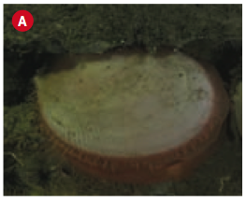
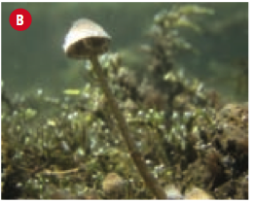
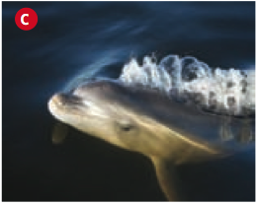
Biodiversity
Biodiversity – The number and variety of life forms present

Slide 9
The opposite of biodiversity
Monoculture: or the growing of one species of organism (ex: a lawn, a wheat field or corn field)
All of the species are identical
Few complex food webs
Disease can spread quickly
Often requires extensive use of pesticides and herbicides to stop nature from biodiversifying

Slide 10
Resilience
Resilience ability of an ecosystem to remain functional and stable in the presence of disturbances (trouble).
Greater diversity offers resistance to:
invasive species
disease

Slide 11
