Slide 1
Day 11 – Threats to Sustainability
SCI 10 Ecosystems

Slide 2
Review for Quiz Thurs
  p.311 #14
  p.312 #6, 8, 20, 22, 26

Slide 3

Matter and energy are recycled through all four of Earth’s systems – lithosphere, the hydrosphere, the atmosphere, and the biosphere.
    Water cycle, carbon cycle, nitrogen cycle, phosphorus cycle, etc.
No new matter has been created since the formations over 4 billion years ago

Slide 4
Eutrophication
http://www.youtube.com/watch?v=LrCVrR5G5vY
Octonauts 0:53-2:30

Slide 5
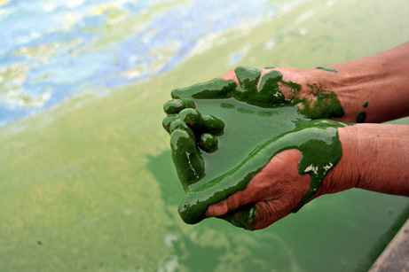
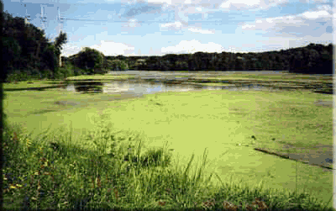
Eutrophication
Caused by run off of nitrogen and phosphorus into waterways (usually from fertilizer use)
Commonly found close to golf courses and farmlands

Slide 6
The process
Eutrophication: deposits of excess nutrients in bodies of water that result in large increases in plant growth
    Phosphates and nitrogen from fertilizers, or sewage, run off into bodies of water
    These nutrients stimulate excessive algae growth = ALGAL BLOOM
    The algae die off and sink to the bottom where they are decomposed by bacteria
      Bacteria use CELLULAR RESPIRATION to decompose the algal remains which uses up most of the OXYGEN at the bottom
      Other fish who live near the bottom die due to lack of oxygen
    The algae bloom blocks sunlight and prevents plants from deeper down from PHOTOSYNTHESIZING

Slide 7
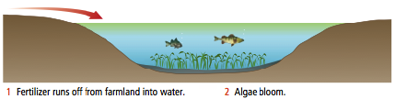
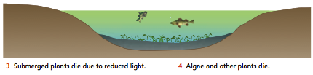
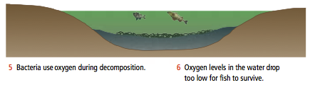

Slide 8
Carbon Dioxide and Other Greenhouse Gases

Slide 9

Greenhouse gases gases that prevent heat from leaving the atmosphere (carbon dioxide CO₂, methane CH₄, etc.)
The greenhouse effect: increased amount of greenhouse gases in our atmosphere leading to an increase in the temperature of Earth

Slide 10
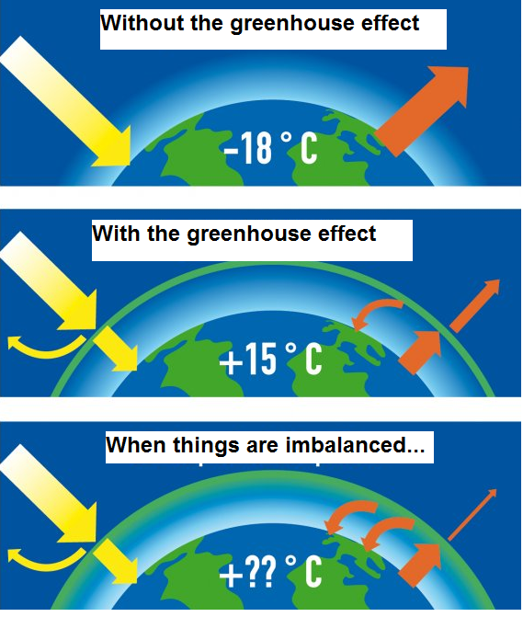
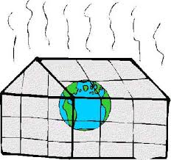
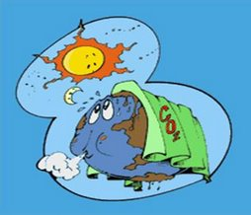

Slide 11

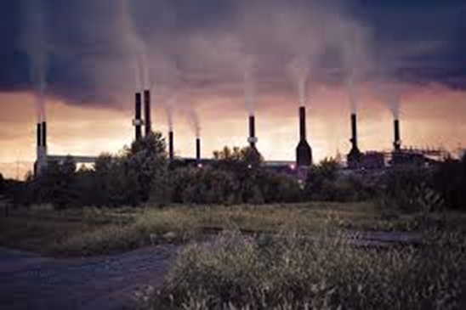
Most matter has cycled through the biosphere countless times
Small amounts have escaped and settled in where there is not enough oxygen to decompose them.
With pressure and heat the materials changed into fossil fuels – Carbon, petroleum and natural gas

Slide 12
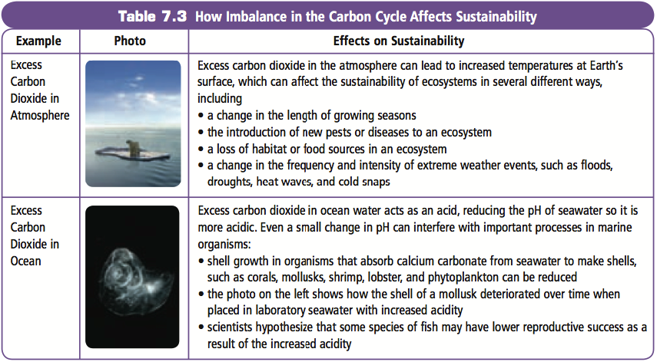
p.305 Effects of Imbalance in Carbon Cycle

Slide 13
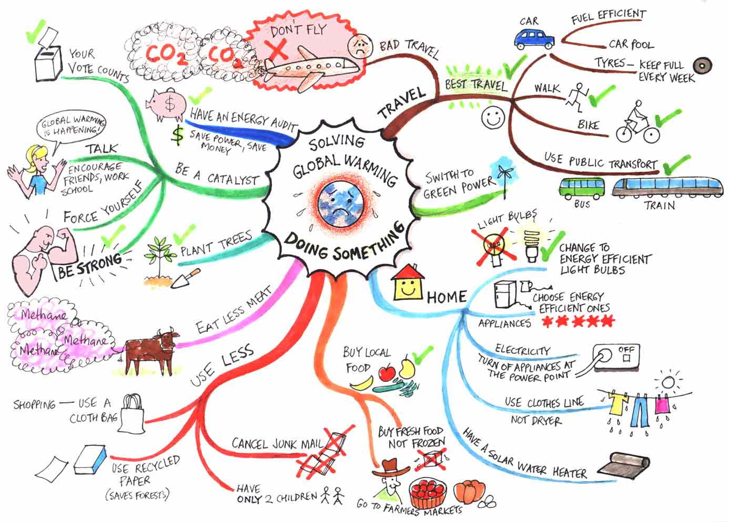

Slide 14
To Do
p.311 #4, 6, 13 (don’t write a letter), 14
Review for Quiz Thurs
  p.311 #14
  p.312 #6, 8, 20, 22, 26

